Slide 1
Gene Prediction Lecture 4
Roji Raut

Slide 2
Gene Prediction
With the rapid accumulation of genomic sequence information, there is a pressing need to use computational approaches to accurately predict gene structure.
Computational gene prediction is a prerequisite for detailed functional annotation of genes and genomes.
The process includes detection of the location of open reading frames (ORFs) and delineation of the structures of introns as well as exons if the genes of interest are of eukaryotic origin.
The ultimate goal is to describe all the genes computationally with near 100% accuracy.

Slide 3
Gene Prediction
The ability to accurately predict genes can significantly reduce the amount of experimental verification work required.
However, this may still be a distant goal, particularly for eukaryotes, because many problems in computational gene prediction are still largely unsolved.
Gene prediction, in fact, represents one of the most difficult problems in the field of pattern recognition.
This is because coding regions normally do not have conserved motifs.
Detecting coding potential of a genomic region has to rely on subtle features associated with genes that may be very difficult to detect.

Slide 4
Gene Prediction
Through decades of research and development, much progress has been made in prediction of prokaryotic genes.
A number of gene prediction algorithms for prokaryotic genomes have been developed with varying degrees of success.
Algorithms for eukaryotic gene prediction, however, are still yet to reach satisfactory results.
Because of the significant differences in gene structures of prokaryotes and eukaryotes, gene prediction for each group of organisms is discussed separately.
In addition, because of the predominance of protein coding genes in a genome (as opposed to rRNA and tRNA genes), the discussion focuses on the prediction of protein coding sequences.

Slide 5
Gene Prediction
The current gene prediction methods can be classified into two major categories, ab initio–based and homology-based approaches.
Ab Initio based method:
The ab initio–based approach predicts genes based on the given sequence alone.
It does so by relying on two major features associated with genes.
The first is the existence of gene signals, which include start and stop codons, intron splice signals, transcription factor binding sites, ribosomal binding sites, and polyadenylation (poly-A) sites.
In addition, the triplet codon structure limits the coding frame length to multiples of three, which can be used as a condition for gene prediction.

Slide 6
Gene Prediction
Ab Initio based method:
The second feature used by ab initio algorithms is gene content, which is statistical description of coding regions.
It has been observed that nucleotide composition and statistical patterns of the coding regions tend to vary significantly from those of the noncoding regions.
The unique features can be detected by employing probabilistic models such as Markov models or hidden Markov models to help distinguish coding from noncoding regions.

Slide 7
Gene Prediction
Homology based methods
The homology-based method makes predictions based on significant matches of the query sequence with sequences of known genes.
For instance, if a translated DNA sequence is found to be similar to a known protein or protein family from a database search, this can be strong evidence that the region codes for a protein.
Alternatively, when possible exons of a genomic DNA region match a sequenced cDNA, this also provides experimental evidence for the existence of a coding region.

Slide 8
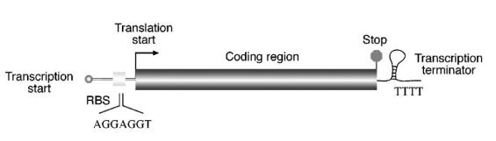
Gene Prediction in prokaryotes
Prokaryotes, which include bacteria and Archaea, have relatively small genomes with sizes ranging from 0.5 to 10 Mbp.
The gene density in the genomes is high, with more than 90% of a genome sequence containing coding sequence.
There are very few repetitive sequences.
Each prokaryotic gene is composed of a single contiguous stretch of ORF coding for a single protein or RNA with no interruptions within a gene.

Slide 9
Gene Prediction in prokaryotes
Detailed knowledge of the bacterial gene structure can be very helpful in gene prediction.
In bacteria, the majority of genes have a start codon ATG (or AUG in mRNA; because prediction is done at the DNA level, T is used in place of U), which codes for methionine.
Occasionally, GTG and TTG are used as alternative start codons, but methionine is still the actual amino acid inserted at the first position.
Because there may be multiple ATG, GTG, or TGT codons in a frame, the presence of these codons at the beginning of the frame does not necessarily give a clear indication of the translation initiation site.

Slide 10
Gene Prediction in prokaryotes
Instead, to help identify this initiation codon, other features associated with translation are used.
One such feature is the ribosomal binding site, also called the Shine-Delgarno sequence, which is a stretch of purine-rich sequence complementary to 16S rRNA in the ribosome.
It is located immediately downstream of the transcription initiation site and slightly upstream of the translation start codon.
In many bacteria, it has a consensus motif of AGGAGGT. Identification of the ribosome binding site can help locate the start codon.

Slide 11
Gene Prediction in prokaryotes
At the end of the protein coding region is a stop codon that causes translation to stop.
There are three possible stop codons, identification of which is straightforward.
Many prokaryotic genes are transcribed together as one operon.
The end of the operon is characterized by a transcription termination signal called ρ-independent terminator.
The terminator sequence has a distinct stem-loop secondary structure followed by a string of Ts.
Identification of the terminator site, in conjunction with promoter site identification can sometimes help in gene prediction.

Slide 12
Gene Prediction in prokaryotes
Determination of open reading frames
Without the use of specialized programs, prokaryotic gene identification can rely on manual determination of ORFs and major signals related to prokaryotic genes.
Prokaryotic DNA is first subject to conceptual translation in all six possible frames, three frames forward and three frames reverse.
Because a stop codon occurs in about every twenty codons by chance in a noncoding region, a frame longer than thirty codons without interruption by stop codons is suggestive of a gene coding region, although the threshold for an ORF is normally set even higher at fifty or sixty codons.

Slide 13
Gene Prediction in prokaryotes
Determination of open reading frames
The putative frame is further manually confirmed by the presence of other signals such as a start codon and Shine–Delgarno sequence.
Furthermore, the putative ORF can be translated into a protein sequence, which is then used to search against a protein database.
Detection of homologs from this search is probably the strongest indicator of a protein-coding frame.

Slide 14
Gene Prediction in prokaryotes
Determination of open reading frames
In the early stages of development of gene prediction algorithms, genes were predicted by examining the non-randomness of nucleotide distribution.
One method is based on the nucleotide composition of the third position of a codon.
In a coding sequence, it has been observed that this position has a preference to use G or C over A or T.
By plotting the GC composition at this position, regions with values significantly above the random level can be identified, which are indicative of the presence of ORFs.

Slide 15
Gene Prediction in prokaryotes
Determination of open reading frames
In practice, because genes can be in any of the six frames, the statistical patterns are computed for all possible frames.
In addition to codon bias, there is a similar method called TESTCODE that exploits the fact that the third codon nucleotides in a coding region tend to repeat themselves.
By plotting the repeating patterns of the nucleotides at this position, coding and noncoding regions can be differentiated.
The results of the two methods are often consistent.
The two methods are often used in conjunction to confirm the results of each other.

Slide 16
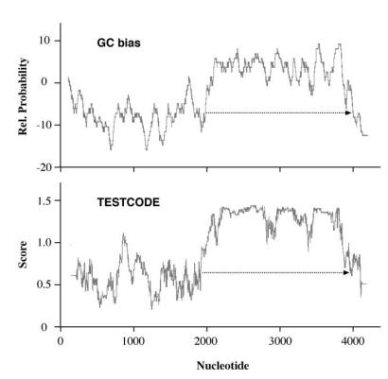
Gene Prediction in prokaryotes
Determination of open reading frames
Coding frame detection of a bacterial gene using either the GC bias or the TESTCODE method.
Both result in similar identification of a reading frame (dashed arrows).

Slide 17
Gene Prediction in prokaryotes
Determination of open reading frames
These statistical methods, which are based on empirical rules, examine the statistics of a single nucleotide (either G or C).
They identify only typical genes and tend to miss atypical genes in which the rule of codon bias is not strictly followed.
To improve the prediction accuracies, the new generation of prediction algorithms use more sophisticated statistical models.

Slide 18
Gene Prediction in prokaryotes
Gene prediction Hidden Markov Model
A Markov model is a stochastic model which assumes that the probability of appearance of a given base (A, T, C, or G) at a given position depends only on the k previous nucleotides.
k is called the order of the Markov model.
Such a model is defined by the conditional probabilities P(X|k previous nucleotides), where X = A, T, G, or C.
In order to build a Markov model, a learning set of sequences on which these probabilities will be estimated is required.
Given a sequence and a Markov model, one can then very simply compute the probability that this sequence has been generated according to this model.

Slide 19
Gene Prediction in prokaryotes
Gene prediction Hidden Markov Model
Markov model exploits the fact that oligonucleotide distribution in coding regions are different from those for non-coding regions.
This can be computed by using various orders of markov models.
The more the value of k, the longer the oligonucleotide unit and the more non randomness which results in more accuracy in prediction of gene.
Because the protein coding gene are composed of nucleotides in triplets, successful markov models are built in sets of three nucleotides, describing non random distributions of trimers or hexamers and so on.
The parameters of markov model has to be trained using a set of sequences with known gene locations.
Once parameters are established it is used in computational prediction.

Slide 20
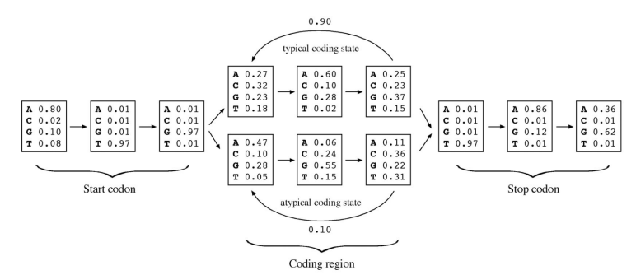
Gene Prediction in prokaryotes
Gene prediction Hidden Markov Model

Slide 21
Gene Prediction in prokaryotes
Gene prediction Hidden Markov Model
Statistical analyses have shown that pairs of codons tend to correlate.
The frequency of 6 nucleotides appearing together is higher than by random chance.
Therefore, a 5th order markov model which calculates the probability of hexamer bases is most often used.
But, if there are not enough hexamers like in shorter genes, a variable-length markov model IMM (Interpolated Markov Model) is used.
IMM (Interpolated Markov Model) samples the largest number of sequence patterns with k ranging from 1 to 8 and uses weighing scheme placing less weight on rare k mers and more on frequent k mers.
Due to presence of different genes in genome and atypical genes may still escape detection hence to fully describe all genes in the genome different markov models are combined and it gives HMM prediction algorithm.

Slide 22
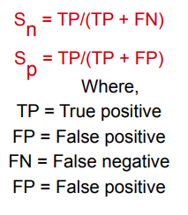
Gene Prediction in prokaryotes
Gene prediction Hidden Markov Model
The accuracy of a prediction program can be evaluated using parameters such as sensitivity and specificity
According to these formulas, sensitivity is the proportion of true signals predicted among all possible true signals.
It can be considered as the ability to include correct predictions.
In contrast, specificity is the proportion of true signals among all signals that are predicted.
It represents the ability to exclude incorrect predictions.

Slide 23
Gene Prediction in prokaryotes
Gene prediction Hidden Markov Model
A program is considered accurate if both sensitivity and specificity are simultaneously high and approach a value of 1.
In a case in which sensitivity is high but specificity is low, the program is said to have a tendency to overpredict.
On the other hand, if the sensitivity is low but specificity high, the program is too conservative and lacks predictive power.

Slide 24
Gene Prediction
Gene prediction Hidden Markov Model
Some HMM/IMM based programs for gene detection
GeneMark (http://exon.gatech.edu/GeneMark/)
Based on 5th order HMMs
Trained for most of the complete microbial organisms
Glimmer (Gene Locator and Interpolated Markov Modeler)
http://ccb.jhu.edu/software/glimmer/index.shtml
UNIX based program
Uses IMM algorithm
2 steps
Model building
Trains using input sequence and optimizes the parameters
Gene prediction
Predicts the gene using different signals and parameters
GlimmerM for eukaryotic gene prediction

Slide 25
Gene Prediction
Gene prediction in Eukaryotes
Eukaryotic nuclear genomes are much larger than prokaryotic ones, with sizes ranging from 10 Mbp to 670 Gbp (1 Gbp = 109 bp).
They tend to have a very low gene density.
In humans, for instance, only 3% of the genome codes for genes, with about 1 gene per 100 kbp on average.
The space between genes is often very large and rich in repetitive sequences and transposable elements.
Most importantly, eukaryotic genomes are characterized by a mosaic organization in which a gene is split into pieces (called exons) by intervening non-coding sequences (called introns).

Slide 26
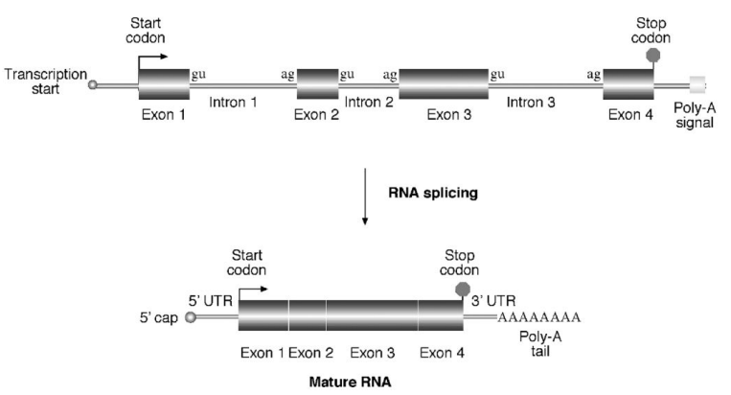
Gene Prediction
Gene prediction in Eukaryotes

Slide 27
Gene Prediction
Gene prediction in Eukaryotes
The main issue in prediction of eukaryotic genes is the identification of exons, introns, and splicing sites.
From a computational point of view, it is a very complex and challenging problem.
Because of the presence of split gene structures, alternative splicing, and very low gene densities, the difficulty of finding genes in such an environment is likened to finding a needle in a haystack.
The needle to be found actually is broken into pieces and scattered in many different places.
The job is to gather the pieces in the haystack and reproduce the needle in the correct order.

Slide 28
Gene Prediction
Gene prediction in Eukaryotes
Ab initio gene prediction
The goal of the ab initio gene prediction programs is to discriminate exons from noncoding sequences and subsequently join the exons together in the correct order.
The main difficulty is correct identification of exons.
To predict exons, the algorithms rely on two features, gene signals and gene content.
Signals include gene start and stop sites and putative splice sites, recognizable consensus sequences such as poly-A sites.
Gene content refers to coding statistics, which includes nonrandom nucleotide distribution, amino acid distribution, synonymous codon usage, and hexamer frequencies.
Among these features, the hexamer frequencies appear to be most discriminative for coding potentials.
To derive an assessment for this feature, HMMs can be used, which require proper training.
In addition to HMMs, neural network-based algorithms are also common in the gene prediction field.

Slide 29
Gene Prediction
Gene prediction in Eukaryotes
Ab initio gene prediction
The nascent transcript from a eukaryotic gene is modified in three different ways before becoming a mature mRNA for protein translation.
The first is capping at the 5’ end of the transcript, which involves methylation at the initial residue of the RNA.
The second event is splicing, which is the process of removing introns and joining exons.
The molecular basis of splicing is still not completely understood.
What is known currently is that the splicing process involves a large RNA-protein complex called spliceosome.
The reaction requires intermolecular interactions between a pair of nucleotides at each end of an intron and the RNA component of the spliceosome.

Slide 30
Gene Prediction
Gene prediction in Eukaryotes
Ab initio gene prediction
To make the matter even more complex, some eukaryotic genes can have their transcripts spliced and joined in different ways to generate more than one transcript per gene.
This is the phenomenon of alternative splicing.
The third modification is polyadenylation, which is the addition of a stretch of As (∼250) at the 3’ end of the RNA.
This process is controlled by a poly-A signal, a conserved motif slightly downstream of a coding region with a consensus CAATAAA(T/C).
For example, the splice junctions of introns and exons follow the GT–AG rule in which an intron at the splice junction has a consensus motif of GTAAGT; and at the splice junction is a consensus motif of (Py)₁₂NCAG

Slide 31
Gene Prediction
Gene prediction in Eukaryotes
Ab initio gene prediction
Some statistical patterns useful for prokaryotic gene finding can be applied to eukaryotic systems as well.
For example, nucleotide compositions and codon bias in coding regions of eukaryotes are different from those of the noncoding regions.
Hexamer frequencies in coding regions are also higher than in the noncoding regions.
Most vertebrate genes use ATG as the translation start codon and have a uniquely conserved flanking sequence call a Kozak sequence (CCGCCATGG).
In addition, most of these genes have a high density of CG dinucleotides near the transcription start site.
This region is referred to as a CpG island, which helps to identify the transcription initiation site of a eukaryotic gene.

Slide 32
Gene Prediction
Gene prediction in Eukaryotes
Ab initio gene prediction using Neural Networks
A neural network (or artificial neural network) is a statistical model with a special architecture for pattern recognition and classification.
It is composed of a network of mathematical variables that resemble the biological nervous system, with variables or nodes connected by weighted functions that are analogous to synapses.
Another aspect of the model that makes it look like a biological neural network is its ability to “learn” and then make predictions after being trained.
The network is able to process information and modify parameters of the weight functions between variables during the training stage.
Once it is trained, it is able to make automatic predictions about the unknown.

Slide 33
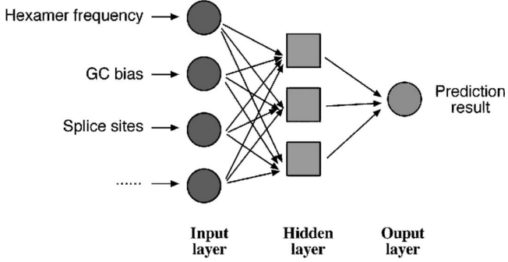
Gene Prediction
Gene prediction in Eukaryotes
Ab initio gene prediction using Neural Networks
In gene prediction, a neural network is constructed with multiple layers; the input, output, and hidden layers.
The input is the gene sequence with intron and exon signals.
The output is the probability of an exon structure.
Between input and output, there may be one or several hidden layers where the machine learning takes place.

Slide 34
Gene Prediction
Gene prediction in Eukaryotes
Ab initio gene prediction using Neural Networks
The machine learning process starts by feeding the model with a sequence of known gene structure.
The gene structure information is separated into several classes of features such as hexamer frequencies, splice sites, and GC composition during training.
The weight functions in the hidden layers are adjusted during this process to recognize the nucleotide patterns and their relationship with known structures.
When the algorithm predicts an unknown sequence after training, it applies the same rules learned in training to look for patterns associated with the gene structures.

Slide 35
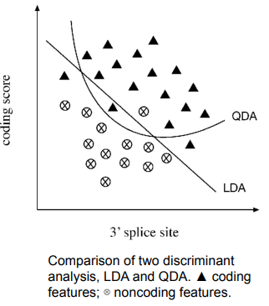
Gene Prediction
Gene prediction in Eukaryotes
Ab initio gene prediction using Discriminate Analysis
Some gene prediction algorithms rely on discriminant analysis, either Linear discriminant analysis (LDA) or quadratic discriminant analysis (QDA), to improve accuracy.
LDA works by plotting a two-dimensional graph of coding signals versus all potential 3’ splice site positions and drawing a diagonal line that best separates coding signals from noncoding signals based on knowledge learned from training data sets of known gene structures.
QDA draws a curved line based on a quadratic function instead of drawing a straight line to separate coding and noncoding features.
This strategy is designed to be more flexible and provide a more optimal separation between the data points.

Slide 36
Gene Prediction
Gene prediction in Eukaryotes
Gene predictor program
To date, numerous computer programs have been developed for identifying eukaryotic genes.
They fall into all three categories of algorithms: ab initio based, homology based, and consensus based.
Most of these programs are organism specific because training data sets for obtaining statistical parameters have to be derived from individual organisms.
Some of the algorithms are able to predict the most probable exons as well as suboptimal exons providing information for possible alternative spliced transcription products.

Slide 37
Gene Prediction
Gene prediction in Eukaryotes
Gene predictor program
GRAIL (Gene Recognition and Assembly Internet Link)
It is a web-based program that is based on a neural network algorithm.
The program is trained on several statistical features such as splice junctions, start and stop codons, poly-A sites, promoters, and CpG islands.
The program scans the query sequence with windows of variable lengths and scores for coding potentials and finally produces an output that is the result of exon candidates.
The program is currently trained for human, mouse, Arabidopsis, Drosophila, and Escherichia coli sequence.

Slide 38
Gene Prediction
Gene prediction in Eukaryotes
Gene predictor program
FGENES
http://www.softberry.com/berry.phtml?topic=fgenesh&group=programs&subgroup=gfind
It is a web-based program that uses LDA to determine whether a signal is an exon.
In addition to FGENES, there are many variants of the program.
Some programs, such as FGENESH, make use of HMMs.
There are others, such as FGENESH C, that are similarity based. Some
programs, such as FGENESH+, combine both ab initio and similarity-based approaches.
MZEF Michael Zhang’s Exon Finder; http://rulai.cshl.org/tools/genefinder/
It is a web based program that uses QDA for exon prediction.
Despite the more complex mathematical functions, the expected increase in performance has not been obvious in actual gene prediction.

Slide 39
Gene Prediction
Gene prediction in Eukaryotes
Gene predictor program
GENSCAN (http://hollywood.mit.edu/GENSCAN.html)
It is a web based program that makes predictions based on fifth-order HMMs.
It combines hexamer frequencies with coding signals (initiation codons, TATA box, cap site, polyA, etc.) in prediction.
Putative exons are assigned a probability score (P) of being a true exon. Only predictions with P > 0.5 are deemed reliable.
This program is trained or sequences from vertebrates, Arabidopsis, and maize. It has been used extensively in annotating the human genome.

Slide 40
Gene Prediction
Gene prediction in Eukaryotes
Gene predictor program
HMMgene (https://services.healthtech.dtu.dk/service.php?HMMgene-1.1)
It is also an HMM-based web program.
The unique feature of the program is that it uses a criterion called the conditional maximum likelihood to discriminate coding from noncoding features.
If a sequence already has a subregion identified as coding region, which may be based on similarity with cDNAs or proteins in a database, these regions are locked as coding regions.
An HMM prediction is subsequently made with a bias toward the locked region and is extended from the locked region to predict the rest of the gene coding regions and even neighboring genes.
The program is in a way a hybrid algorithm that uses both ab initio-based and homology-based criteria.

Slide 41
Gene Prediction
Gene prediction in Eukaryotes
Homology based programs
Homology-based programs are based on the fact that exon structures and exon sequences of related species are highly conserved.
When potential coding frames in a query sequence are translated and used to align with closest protein homologs found in databases, near perfectly matched regions can be used to reveal the exon boundaries in the query.
This approach assumes that the database sequences are correct.
It is a reasonable assumption in light of the fact that many homologous sequences to be compared with are derived from cDNA or expressed sequence tags (ESTs) of the same species.

Slide 42
Gene Prediction
Gene prediction in Eukaryotes
Homology based programs
With the support of experimental evidence, this method becomes rather efficient in finding genes in an unknown genomic DNA.
The drawback of this approach is its reliance on the presence of homologs in databases. If the homologs are not available in the database, the method cannot be used.
Novel genes in a new species cannot be discovered without matches in the database.

Slide 43
Gene Prediction
Gene prediction in Eukaryotes
Homology based programs
GenomeScan (http://hollywood.mit.edu/burgelab/software.html)
It is a web-based server that combines GENSCAN prediction results with BLASTX similarity searches.
The user provides genomic DNA and protein sequences from related species.
The genomic DNA is translated in all six frames to cover all possible exons.
The translated exons are then used to compare with the user-supplied protein sequences.
Translated genomic regions having high similarity at the protein level receive higher scores.
The same sequence is also predicted with a GENSCAN algorithm, which gives exons probability scores.
Final exons are assigned based on combined score information from both analyses.

Slide 44
Gene Prediction
Gene prediction in Eukaryotes
Homology based programs
EST2Genome (http://www.bioinformatics.nl/cgi-bin/emboss/est2genome)
It is a web-based program purely based on the sequence alignment approach to define intron–exon boundaries.
The program compares an EST (or cDNA) sequence with a genomic DNA sequence containing the corresponding gene.
The alignment is done using a dynamic programming–based algorithm.
One advantage of the approach is the ability to find very small exons and alternatively spliced exons that are very difficult to predict by any ab initio–type algorithms.
Another advantage is that there is no need for model training, which provides much more flexibility for gene prediction.
The limitation is that EST or cDNA sequences often contain errors or even introns if the transcripts are not completely spliced before reverse transcription.

Slide 45
Gene Prediction
Gene prediction in Eukaryotes
Homology based programs
SGP-1 (https://pubmed.ncbi.nlm.nih.gov/11544202/)
It is a similarity-based web program that aligns two genomic DNA sequences from closely related organisms.
The program translates all potential exons in each sequence and does pairwise alignment for the translated protein sequences using a dynamic programming approach.
The near-perfect matches at the protein level define coding regions. Similar to EST2Genome, there is no training needed.
The limitation is the need for two homologous sequences having similar genes with similar exon structures; if this condition is not met, a gene escapes detection from one sequence when there is no counterpart in another sequence.

Slide 46
Gene Prediction
Gene prediction in Eukaryotes
Homology based programs
TwinScan (https://pubmed.ncbi.nlm.nih.gov/16597247/) https://mblab.wustl.edu/software.html
It is also a similarity-based gene-finding server.
It is similar to GenomeScan in that it uses GenScan to predict all possible exons from the genomic sequence.
The putative exons are used for BLAST searching to find closest homologs.
The putative exons and homologs from BLAST searching are aligned to identify the best match.
Only the closest match from a genome database is used as a template for refining the previous exon selection and exon boundaries

Slide 47
Gene Prediction
Consensus-based programs
Because different prediction programs have different levels of sensitivity and specificity, it makes sense to combine results of multiple programs based on consensus.
This idea has prompted development of consensus-based algorithms.
These programs work by retaining common predictions agreed by most programs and removing inconsistent predictions.
Such an integrated approach may improve the specificity by correcting the false positives and the problem of overprediction.
However, since this procedure punishes novel predictions, it may lead to lowered sensitivity and missed predictions.

Slide 48
Gene Prediction
Consensus-based programs
GeneComber (https://academic.oup.com/bioinformatics/article/19/10/1296/184327)
It is a web server that combines HMMgene and GenScan prediction results.
The consistency of both prediction methods is calculated. If the two predictions match, the exon score is reinforced.
If not, exons are proposed based on separate threshold scores.
DIGIT (https://www.ncbi.nlm.nih.gov/pmc/articles/PMC3042383/)
It is another consensus-based web server. It uses prediction from three ab initio programs – FGENESH, GENSCAN, and HMMgene.
It first compiles all putative exons from the three gene-finders and assigns ORFs with associated scores.
It then searches a set of exons with the highest additive score under the reading frame constraints.
During this process, a Bayesian procedure and HMMs are used to infer scores and search the optimal exon set which gives the final designation of gene structure

Slide 49
DNA Microarray
Microarray technology evolved from Southern blotting.
The concept of microarrays was first proposed in the late 1980s by Augenlicht and his colleagues.
They spotted 4000 cDNA sequences on nitrocellulose membrane and used radioactive labeling to analyze differences in gene expression patterns among different types of colon tumors in various stages of malignancy.
The large scale genome sequencing effort and the ability to immolize thousands of DNA fragments on coated glass slide or membrane, have led to the development of microarray technology.

Slide 50
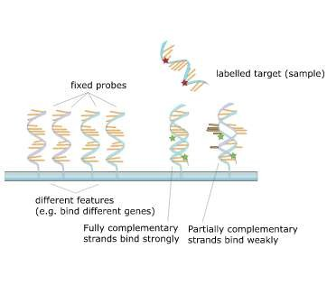
Microarray
A microarray is a pattern of ssDNA probes which are immobilized on a surface called a chip or a slide.
Microarrays use hybridization to detect a specific DNA or RNA in a sample.
DNA microarray uses a million different probes, fixed on a solid surface.
The core principle behind microarrays is hybridization between complementary DNA strands.
Fluorescent labelled target sequences that bind to a probe sequence generate a signal that depends on the strength of the hybridization determined by the number of paired bases.

Slide 51
DNA microarray technology
DNA microarray technology may be defined as a high-throughput and versatile technology used for parallel gene expression analysis for thousands of genes of known and unknown functions.
Used for detection of polymorphisms and mutations in genomic DNA
A DNA microarray is a collection of microscopic DNA spots on solid surface. Each spot contains picomoles of a specific DNA sequences, known as probes or reporters.
The main purpose of microarray is to detect the presence and abundance of labelled nucleic acids in a biological sample, which will hybridize the DNA on the array via Watson-Crick duplex formation, and which can be detected via the label.

Slide 52
Working with DNA microarray
Steps involved:
Sample preparation and labeling
Hybridization
Washing
Image acquisition

Slide 53
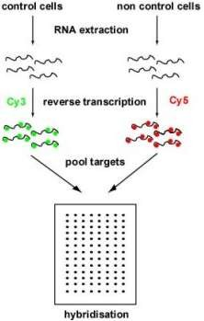
Sample preparation and labelling
Isolate a total RNA containing mRNA that ideally represents a quantitative copy of genes expressed at the time of sample collection.
Preparation of cDNA from mRNA using a reverse-transcriptase enzyme.
Short primer is required to initate cDNA synthesis.
Each cDNA (Sample and Control) labelled with fluorescet cyanine dyes (ie Cy3, Cy5)

Slide 54
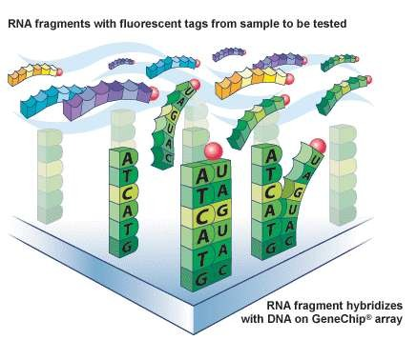
Array Hybridization
Here, the labelled cDNA (Sample and Control) are mixed together.
Purification
After purification, the mixed cDNA is hybridized ie. Forms heteroduplexes with the DNA probes on the glass via Watson Crick base pairing.

Slide 55
Washing
After hybridization, the slides are washed
Two main reasons
To remove excess hybridization solution from the array and ensure only labelled target on the array is the target that has specifically bound on the array
To increase the stringency of the experiment by reducing cross-hybridization. The aim is that the hybridized DNA will remain bound on the array.

Slide 56
Image Acquisition
The heteroduplexes on the array, where the target has bound to the probe, contain dye that fluoresces when excited by light of an appropriate wavelength.
A laser is used to excite the dyes incorporated into the heteroduplexes on the surface of the array.
The fluorescence of the dye is them measured by a photomultiplier tube (PMT) and converted into digital signal.
The slide (or in some scanners, the optics) is moved so that the laser excites the whole of the slide.
Two color arrays are scanned twice: once with green laser (for Cy3) and once with red laser (for Cy5).

Slide 57
Clustering Gene expression profiles
For microarray data, clustering analysis identifies coexpressed and coregulated genes.
Genes within a category have more similarity in expression than genes from different categories.
When genes are coregulated, they normally reflect related functionality.
Through gene clustering, functions of previously uncharacterized genes may
be discovered.
Clustering methods include hierarchical clustering and partitioning clustering (e.g., k-means, self-organizing maps [SOMs]).

Slide 58
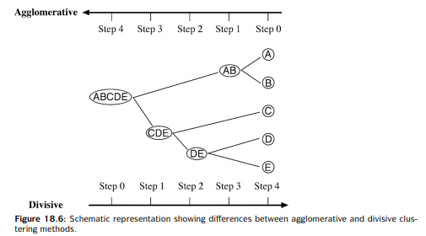
Clustering approaches
The clustering algorithms can be further divided into two types, agglomerative and divisive. An agglomerative method begins by clustering the two most similar data points and repeats the process to successively merge groups of data according to similarity until all groups of data are merged. This is also known as the bottom-up approach.
A divisive method works the other way around by lumping all data points in a single cluster and successively dividing the data into smaller groups according to dissimilarity until all the hierarchical levels are resolved. This is also called the top-down approach.

Slide 59
Hierarchical Clustering.
A hierarchical clustering method is in principle similar to the distance phylogenetic tree-building method.
It produces a treelike structure that represents a hierarchy or relative relatedness of data groups.
In the tree leaves, similar gene expression profiles are placed more closely together than dissimilar gene expression profiles. The tree-branching pattern illustrates a higher degree of relationship between related gene groups.
When genes with similar expression profiles are grouped in such a way, functions for unknown genes can often be inferred. Hierarchical clustering uses the agglomerative approach that works in much the same way as the UPGMA method, in which the most similar data pairs are joined first to form a cluster. The new cluster is treated as a single entity creating a reduced matrix.
The reduced matrix allows the next closest data point to be added to the previous cluster leading to the formation of a new cluster. By repeating the process, a dendrogram showing the clustering pattern of all data points is built.

Slide 60
k-Means Clustering.
In contrast to hierarchical clustering algorithms, k-means clustering does not produce a dendrogram, but instead classifies data through a single step partition. Thus, it is a divisive approach.
In this method, data are partitioned into k-clusters, which are prespecified at the outset. The value of k is normally randomly set but can be adjusted if results are found to be unsatisfactory.
In the first step, data points are randomly assigned to each cluster.
The average of the data in a group (centroid value) is calculated.
The distance of each data point to the centroid is also calculated.
The second step is to have all the data points randomly reassigned among the k-clusters.
The centroid of each cluster and distances of data points to the centroid are recomputed.
Then each data point is reassigned to a different cluster.
If a data point is found to be closer to the centroid of a particular cluster than to any other cluster, that data point is retained in the partition.
Otherwise, it is subject to reassignment in the next iteration. This process is repeated many times, until the distances between the data points and the new centroids no longer decrease. At this point, a final clustering pattern is reached

Slide 61
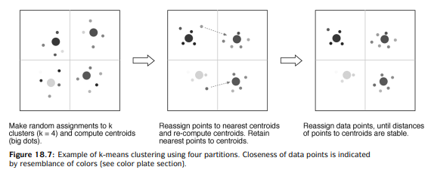
This process is repeated many times, until the distances between the data points and the new centroids no longer decrease. At this point, a final clustering pattern is reached

Slide 62
Self-Organizing Maps.
Clustering by SOMs is in principle similar to the k-means method.
This pattern recognition algorithm employs neural networks.
It starts by defining a number of nodes.
The data points are initially assigned to the nodes at random.
The distance between the input data points and the centroids are calculated.
The data points are successively adjusted among the nodes, and their distances to the centroids are recalculated.
After many iterations, a stabilized clustering pattern are reached with the minimum distances of the data points to the centroids.

Slide 63
K means and SOM
The differences between SOM and k-means are that, in SOM, the nodes are not treated as isolated entities, but as connected to other nodes.
The calculation of the centroid values in SOM takes into account not only information from within each cluster, but also information from adjacent clusters.
This allows the analysis to be better at handling noisy data. Another difference is that, in SOM, some nodes are allowed to contain no data at all.
Thus, at the completion of the clustering, the final number of clusters may be smaller than the initial nodes.
This feature renders SOM less subjective than k-means. However, this type of algorithm is also much slower than the k-means method.

Slide 64
MICROARRAY DATABASES
repository containing microarray gene expression data
The key uses of a microarray database are to
store the measurement data,
manage a searchable index, and
make the data available to other applications for analysis and interpretation (either directly, or via user downloads)
Some of the most popular ones include
Array Express
Gene Expression Omnibus (GEO)
Stanford Microarray database
ExpressDB
Genex

Slide 65
Clustering programs/ Tools
Cluster (http://rana.lbl.gov/EisenSoftware.htm) is a Windows program capable of hierarchical clustering, SOM, and k-means clustering. Outputs from hierarchical clustering are visualized with the Treeview program.
EPCLUST (www.ebi.ac.uk/EP/EPCLIST) is a web-based server that allows data to be uploaded and clustered with hierarchical clustering or k-means methods. In addition, the user can perform data selection, normalization, and database similarity searches with this program.
TIGR TM4 (www.tigr.org/tm4) is a suite of multiplatform programs for analyzing microarray data. This comprehensive package includes four interlinked programs, TIGR spot finder (for image analysis), MIDAS (for data normalization), MeV (for clustering analysis and visualization), and MADAM (for data management). The package provides different data normalization schemes and clustering options.
SOTA (Self-Organizing Tree Algorithm; www.almabioinfo.com/sota/) is a web server that uses a hybrid approach of SOM and hierarchical clustering. It builds a tree based on the divisive approach starting from the root node containing all data patterns. Instead of using the distance-based criteria to resolve a tree, the algorithm using the neural network based SOM algorithm to separate clusters of genes at each node. The homogeneity of gene clusters at each node is analyzed using SOM. The tree building stops at any point if desired homogeneity level is reached.

Slide 66
Applications
Biomedical Research:
Disease Gene Discovery: Identifying genes associated with diseases, such as cancer or genetic disorders.
Personalized Medicine: Tailoring treatments based on individual gene expression profiles.
Biotechnology:
Agricultural Applications: Identifying genes for crop improvement.
Industrial Microbiology: Engineering microbes for optimized production of biofuels, enzymes, etc.

Slide 67
Applications
Human Genome Project: Used ab initio and homology-based methods to map and identify genes in the human genome.
Alzheimer's Disease Research: Identified differentially expressed genes in Alzheimer’s patients using microarray analysis.
Plant Drought Response: Revealed key regulatory genes involved in drought resistance in plants through microarray analysis.
Cancer Drug Target Discovery: Mined gene expression data to identify overexpressed genes in tumors as potential drug targets.
Panda Genome Annotation: Combined ab initio prediction and RNA-Seq data to annotate the panda genome, aiding conservation efforts.
Breast Cancer Subtypes: Identified molecular subtypes of breast cancer using gene expression profiling, leading to targeted therapies.
Alternative Splicing in Human Tissues: Predicted tissue-specific alternative splicing events using RNA-Seq data.
Toxicogenomics Study: Used microarray analysis to profile gene expression changes in response to environmental pollutants.

Slide 68
Thank You !!!

